Slide 1
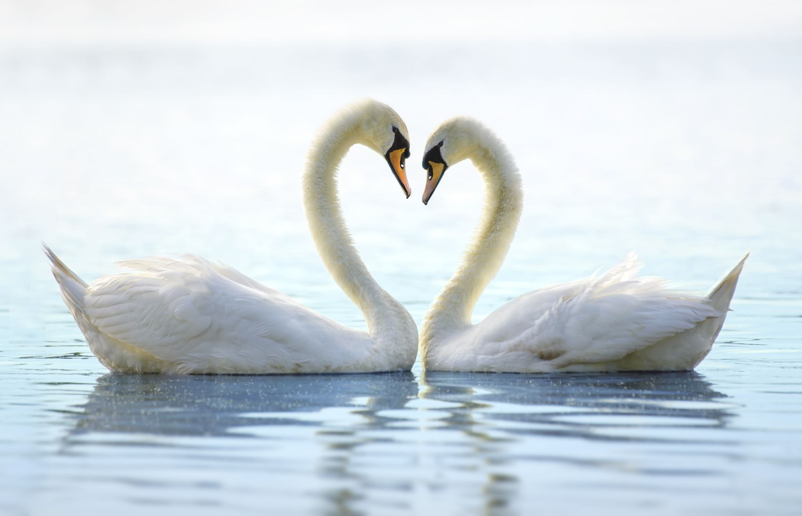
My Peace
My Responsibility

Slide 2
My Peace and my purpose
Who am I? Am I who I want to be? Am I what I choose to think? Am I what I feel? Am I what I choose to speak? Am I how I behave? Am I my will to become more righteous? Is my Peace to be found in my Freewill?
Do I cause division or am I Peaceful?
Am I the same person that I was yesterday? Am I the same person that I will become tomorrow?
Who do I want to become?
What is my Purpose? Am I my own purpose or is there a purpose that is Higher than Me?
What does success mean to me? Is my success related to that which is temporary and physical or is my success related to the success of those that I love?
How can my Peace help me find success in fulfilling my True purpose? How can fulfilling my True purpose help me to find Peace within and with the rest of Creation?
How can seeking my righteousness bring me to finding my Peace? How can finding Peace help me to pursue my paths of righteousness?

Slide 3
My Peace
What do I understand by my ‘Peace?’
01
Why is my Peace important?
02
How can my Peace help me?
03
How can my peace help others?
04
How can I become more peaceful?
05

Slide 4
What is my Peace?
How would I seek, understand and appreciate the concept of my Peace, without the existence of war and chaos?
What need would there be for Peace, if there was no evil? What is the pursuit of Peace if not the pursuit of Goodness and righteousness?
What is my Peace, without my Truth, my Justice, and my Love?
Am I peace with myself? Do I speak truth, love others as myself and pursue justice?

Slide 5
Why is my Peace important?
How can there be unity without peace?
How can I have a meaningful relationship with another, without seeking Peace and Unity?
How can I have a meaningful relationship and better know myself if I cannot be at peace with myself?
How can I be at peace with others if I am not at peace with myself?
How can there be world peace, without my peace?
How can I be One with my Creator if I do not seek peace and unity within myself and with others?

Slide 6
How can my peace help me?
How can becoming more at Peace with myself and others help me heal from mental, emotional, physical and spiritual distress?
How can my peace help me find and pursue my life purpose, staying true to who I am?
How can my seeking peace help me to treat others as myself, and therefore better pursue justice?
How can my seeking Peace help me to refine my character and Glorify my Creator?
How can my seeking Peace help me have a more meaningful Relationship with my Creator and with the rest of Creation in Oneness?

Slide 7
How can my peace help others?
Are others more or less likely to feel at peace in my presence, if I am at peace with myself?
How can I speak words of peace that seek to unite others, if I am unable to find peace in my own thoughts and emotions, and if I am unable to control my behaviour?
How can I extinguish war that is external to me, if I am unable to extinguish or overcome the battle that is within myself?
How can I strive for world peace through pursuing my own righteousness?

Slide 8
Am I at peace?
Am I at peace in my own company or do I rely on the company of others to feel my peace?- if so –why? Am I trying to escape my own battle ground of my darkness? Do I rely on others to bring me to peace?
Am I more at peace in my own company than when I am around others- if so- why? Will my own Light give me an everlasting peace if I cannot have a meaningful relationship and share my light with others? What if my light runs out? Do I want to keep my light to myself? Is this the purpose of my creation?- to hide from war? How can I truly be at peace with myself if I do not help my fellow human find their own light of Peace to help them out of their darkness and inner chaos?

Slide 9
How can I become more peaceful?
How can seeking knowledge, wisdom, understanding and love help me find more inner peace?
How can mindfulness, self-reflection, prayer and mediation help me to gain courage to seek the hidden treasures within my own chaotic thoughts, emotions and negative experiences to help me rise above the evil inclinations of my heart which lead me to battle with myself and hold me back from my true purpose?
How can the pursuit of Truth, Justice and acts of loving kindness help me to become more at peace with myself and others?
How can my humility, gratitude, respect, obedience, courage, compassion, forgiveness, patience, perseverance, hope, joy, and faith help me find my peace?
How can surrender to a Will and Purpose higher than myself help me to lead a life of servitude and self sacrifice so that I can treat others how I want to be treated, and love others as myself? How can this help me purify myself and my relationships so that I can live at peace not only with myself but with others in my community and with my Creator?

Slide 10
My Peace and my thoughts
Are my thoughts peaceful or chaotic?
Do I seek Truth in my thought process?
How does my intellect affect my thoughts? How can my reason and logic help me find a better understanding about myself and who I choose to be?
Do I rely on my own intellect and understanding to help find my peace? Am I able to be at Peace with myself even If I do not yet ’understand’?
Is the destination of Truth which brings me Peace, or is it the process and journey of seeking Truth and understanding that brings me peace? How can Surrendering to a Will that is Higher than my own, help me to be at peace even though I have not yet reached Truth?
Are my thoughts at ‘One’ with each other or is there a war in my brain?
How does my Will, and what I desire affect my thoughts? Do my thoughts have control over my will or does my will help direct my thoughts? How can I become more at Peace with my throughs and have better control over them by using my free will to choose what to desire? How can I choose what to desire in a way that brings Peace by choosing good over evil, and a path of love peace and justice?
What do I choose to think about- how to cause division and harm towards others, or how to make peace between my brethren?
How can the battle of my thoughts help lead me to a Higher Truth?

Slide 11
My Peace and my emotions
Do my emotions bring me Peace? –if not- why not? Do I choose to feel that which leads to destruction, division and war within myself and between others?
How are my emotions related to the way I behave? Do I choose to behave in a way that leads to chaotic emotions and feelings within myself? Do I choose not to speak and behave in a way that enables me to be true to myself and who I want to become?
How are my emotions related to my Truth? How can my emotions help me to find my path of Truth by causing me to feel anxious and depressed and distressed during times that I do not pursue my True purpose?
Do my thoughts have control over my emotions?
Am I able to choose what I think? Am I therefore able to choose what I feel?
How can gaining mastery over my emotions help me to rise above my evil inclinations and pursue a path of righteousness which brings me to my Peace?

Slide 12
My Peace and my speech
Do I speak what I think? Do I speak Truth? –if not why not? How does this affect my ability to feel my Peace?
Do I choose to speak words which help bring peace and unity amongst my brethren? Or does my speech lead to destruction and division?
How can my choice of words of Peace that I say unto others, help me to be more at peace with myself?

Slide 13
My Peace and my behavior
Do I behave in a way that is ‘peaceful?’ – if not why not? Does it bring me peace to cause harm and division amongst myself and my brethren?
How can my words of Peace, and my Truth ( being true to my word) help bring me to a more peaceful ‘way’ of life in my behavior?
How can my peaceful way of life help me to lives in Unity with the rest of creation in its diversity? How can living in unity with my brethren help me to be One with our Creator in Peace?

Slide 14
My Peace and my wellbeing
How does my ‘peace of mind’ affect my emotional wellbeing? Am I more or less likely to feel anxious or depressed if I am at peace with myself and others?
How does my ‘peace of mind’ affect my physical wellbeing? Am I more or less likely to feel physical pain and tiredness if I am at Peace with myself and others?

Slide 15
My Peace and my Evil inclinations
How does my ego, my greed, my envy, my lust, my sloth, my gluttony, my anger and vengeance, prevent me from seeking and attaining my Peace?
Are my evil inclinations real? Or are they just a delusion? Are they True? Or are they falsehood? Is falsehood my enemy or can I make peace with my falsehood? How can I make peace with my falsehood?
Do my evil inclinations enable or prevent me from making peace between my brethren and the rest of creation?
How can I be at peace with myself if my evil inclinations are at war with my side of righteousness? Am I able to choose which path I choose? Which path is more in line with my Truth and therefore my ultimate Peace?
Can I choose to engage in war over my evil inclinations in pursuit of my Peace or is war itself not peaceful?
How else can I overcome my evil inclinations in order to ease my path of righteousness and Peace?
What is the most peaceful weapon I can use against myself in order to seek and attain my Peace? Should I kill myself in order to save myself or am I able to transform myself into a new creation?- if so- how?

Slide 16
My Peace and my darkness
Am I able to use my Truth as my weapon against my falsehood to help light up the darkness within my soul which hides my Peace?
How can I find the light of my Truth if I am not truthful in my speech and behavior and if I am not true to myself and what I believe to be true?
How can I attain peace in my darkness if I am afraid to take responsibility of my life?
How can I expect to gain light from others if I do not treat others how I myself would want to be treated?
How can seeking a path of Truth and Justice and Love with courage help me to find my Light and therefore my Peace?
Is there Peace to be found in my darkness?
Am I able to transform my darkness into Light?- if so – how? How can an act of loving kindness help to light up my world by lighting up the world of another?

Slide 17
My peace and my sorrows
Am I at peace with my sorrows? If not- why not? Is there not a treasure of wisdom that I can gain from my negative experiences?
Why do I sorrow? Why do I grieve? Is it because of the loss of control, loss of wealth, the loss of lives, the loss of health and the lack of justice in my world? Is there nothing good that I can learn from my hardship and struggles? But what is anything good without my experience of its opposite? How can I become more grateful if I do not have a comparison of light with darkness, good with evil, truth with falsehood, reality with delusion?
How can my seeking and gaining of wisdom and understanding from my suffering and the suffering of others, help me to be more at Peace with my sorrows so that I can transform them into Joy?

Slide 18
My peace and my fears
Am I at peace with my fears? What am I afraid of? And why? Death? Punishment? Failure? Suffering? Pain? Losing my relationship? How can understanding what I I am afraid of and the reason behind this- help me to work on my fears so that I can transform my fear into courage in my path towards Peace?
Am I afraid of the Dark? Or am I afraid of facing the Truth/Light that is hiding in my darkness?
How can my darkness be ‘Real’ if it does not contain an element of my truth or light?
How can I perceive and recognize light to be light and truth to be truth if I am too afraid to perceive my darkness and falsehood?
Is my darkness where my Peace is hiding from me? How can my courage help me to be at peace even in my darkness?
Am I afraid of my darkness? Do I try to escape it? How can I find my falsehood if there is no light with which to see? How can I find my own light to enable me to find my falsehood so that I may destroy it with my Truth? Does anyone want to share their light with me? Why should they? Do I share my light with others in their hour of darkness?

Slide 19
My Peace and my Responsibility
How do I choose to spend my time? Do I use my time to escape from my responsibilities? Do I use my time to distract myself from reflecting on myself and my experiences/ the experience of others so that I can grow spiritually? Do I use my time to pursue my worldly pleasures that are driven by my ego and lust and envy and greed to pursue my own interest and happiness in this physical existence?
Do I take responsibility for my choices?
Am I at peace with how much responsibility I choose to take over my life and choices?
How can my pursuit of a path of Peace help me to take more responsibility in my life and fulfil my highest potential in fulfilling my purpose in this world?

Slide 20
My Peace and my Time
Does time belong to me? If not then why do I use it to pursue my own pleasures?
Do I share my time with others? Do I use my time to help others in need? Do I use my time wisely?
Do I waste time trying to forget my troubles by indulging in harmful speech and behavior such as intoxicants, gossiping and slander?
Am I in control of my time? Am I in control of anyone else’s time?
Am I able to bring back yesterday or control what happens tomorrow according to my own will?
Do I try to control Time? If so- how does this affect my ability to be at Peace with myself and my Source of Existence?
Do I live in my past sorrows and choose to be a victim of my negative experiences?
Do I worry about what tomorrow might bring or do I welcome its blessings ( even though it may be in disguise) according to the Will of That which is Higher than myself?
How can ‘letting go’ of my desire to control time help me to be more at Peace with myself and my universe?

Slide 21
My Peace and my light
What is Peace if not Light?
What is Light if not Truth?
What is Light without darkness? What is Truth without falsehood?
What is Reality without delusion? How can delusion exist without being mixed with truth? How can the physical reality exist if it does not contain both light and darkness, truth and falsehood?
What is darkness without falsehood?
What is falsehood without Truth?
What is Truth without Justice?
What is Justice without sin?
What is sin without ego? What is ego without hatred? What is hatred without love? What is evil without sin?
What is good without evil? How am I able to perceive, know, understand and love a Higher Good without knowing evil and sin?
How can I be human and serve that which is Higher than myself to the best of my potential if I do not make mistakes? How can I reach higher states of consciousness without diving deep into the darkness of my soul?
How can my seeking of Truth and Peace help me to transform my darkness into Light?

Slide 22
My Peace and my courage
How can my courage help me to be at peace even as I walk through the valley of the shadow of death?
How can I find more courage?
Can my faith and trust in my Creator help me find courage? Can my Hope help me? What is the Source of my Faith and Hope? Is my Truth the Source of my Faith? Is my Creator the Source of my Higher Truth? Must I surrender myself to and obey the Will of my Creator in order to have Faith and therefore find courage to discover and pursue my Peace?
How can my courage help me to be more at peace with death, hardship and struggle?
How can my courage help me to keep walking into the chaos of this physical world so that I may help calm the storm that is within and around me with my Peace?
How can my courage help me to take responsibility of my thoughts, emotions, speech and behavior so that I can refine my character traits, improve my relationships with myself, others and my Creator and become a vessel of Higher love and light and peace unto others?

Slide 23
My Peace and my Respect
Am I at Peace with my Respect?
Am I more or less able to be at peace with myself if I do not respect myself? How can I better respect myself? Am I true to myself?
Am I more or less able to be at peace with others if I do not Respect their freedom to choose?
How can I be at peace with myself without respecting the roles of the different parts of myself that make me complete and enable me to function properly?
How can I be at peace and live in Unity with others and function in my community in peace if I do not respect the roles and differences in diversity of the rest of creation?
How can my head function in a healthy balance without respecting the heart? How can my heart function in a healthy balance without respecting the head? How can my hands and feet function according to a Higher Will other than their own if they do not respect and obey the commands of the head?
How can my society become more just and live in peace and unity without respecting one another despite our differences in our diverse ways?
How can I truly attain peace without treating others as I want to be treated?

Slide 24
My Peace and my Obedience
Does my obedience bring me Peace? –if not why not? Do I believe I know better than that which I am told to obey? Is what I choose to obey, not Just? Is it not Truthful? Is it not Real?
Should I rebel and break the rules just because they do not bring me peace? What is more important to me?- my peace or being at peace with others?
What do I choose to serve? What do I choose to worship? What is worship without obedience? Do I worship myself or do I choose to worship that which is Higher than Myself? Do I choose to serve others or do I choose to serve only myself? Do I worship my Creator or are the evil inclinations of my heart which bring only a temporary pleasure my gods? Do I obey Truth which is Real and Just, even if it goes against myself, or do I obey my falsehood which leads to a temporary joy and delusion?
Can I attain my inner Peace without obedience to my inner Truth? Can I attain higher levels of Peace without obedience to a Truth that is Higher than my own understanding?
Can I attain Peace in my external environment without obedience to the High Court of Justice?
Which court of Justice do I choose to obey? Is there a Universal Higher Law that can be the foundation of my Peace and Obedience?
What happens if the Law of my external environment contradicts my inner sense of morality and principles? Which one should I obey? The voice from outside of me or inside of me? Is there a way I can obedient to both?
Am I more or less likely to be at Peace with myself if I rebel against my own principles and morals?
Am I more or less likely to be at Peace with others in my society if I break the law?
What guides me to decide what I believe to be right and wrong, good and evil? How can my Peace through peaceful speech and behavior which helps to unite rather than divide, help me to have better judgement of right and wrong, and find my morality and truth which I can then obey?
Can my seeking Truth and Peace from that which is Higher than myself, bring me to become more obedient so that that I live in peace with others? How can surrender to a Higher Will help bring me to my Pecae?

Slide 25
My Peace and my gratitude
Can I be truly grateful without my Peace? Can I truly be at Peace without my Gratitude?
Does it bring me peace to show gratitude to those that help me? How can the expression of my gratitude towards others help bring peace to others, thereby improve my relationships with others? How can improving my relationship with others bring more peace to myself and others and increase the love between us?
Am I more or less likely to live in peace with those who appreciate my efforts?
Am I more or less likely to live at Peace with my Creator within me, if I show Him appreciation for my blessings by sharing them with others?
What brings me more peace?- To show gratitude or to receive gratitude? Who is the Source of my blessings and therefore most worthy of my gratitude? How can the expression of my gratitude to my Creator, through serving others ( without expectation of return from them) help me to attain Higher levels of my peace?

Slide 26
My Peace and my humility
Can I have true everlasting peace without sincere humility? How can my inner and outer chaos, suffering and and destruction bring me to humble myself so that I cam more able to seek and find my Peace?
How can my humility help me to willingly surrender my ways that are driven by my ego and which lead me to sin and chaos, to the Will of the Source of my Truth, so that I can attain a state of Peace with myself and become a vessel of a Higher Love and Light that brings Peace unto others?
How can my humility help me to love others as myself and therefore treat others as I want to be treated? How can this help me live more peacefully with others in my community?
How can my humility help me to better serve my Creator through serving humanity and respecting His creation?
How can my humility bring me to expect less from others, so that I can rely solely on my Creator and be at peace even when I am at a loss or do not receive worldly from others for my efforts?
Does my Peace belong to me? Am I the Creator of and Source of my Peace? Do I deserve the glory of my righteousness that has brought me to my Home of Peace? How can my humility help me to direct all glory and honor to Praise my Creator, and my Giver of Peace - who created me, guided me, had mercy on me, and enabled me to find and receive my inner Peace?

Slide 27
My peace and my Forgiveness
Can I be at peace with myself if I do not feel worthy of forgiveness? How can I be forgiven if I do not repent and mend my ways? How can having faith in the forgiving nature of my Creator- The Source of my Forgiveness and the Most Forgiving and Merciful One- help bring me to repentance so that I can let go of the anxieties of my past mistakes and more easily take responsibility over my present and future speech and behavior?
Can I be at peace with others if I do not forgive and pardon their mistakes? Am I more or less likely to be able to easily forgive others if I do not seek to make peace with them? How can seeking to make peace between my brethren, help me to more easily forgive and pardon others, so that I can more easily live in Unity with them?
How can my seeking Peace help bring me to repentance and forgiveness? How can my repentance and forgiveness of others help bring me to a Higher Peace?

Slide 28
My peace and my love
What is True Peace without True Love? Can I be at peace in my heart if I am not able to give or receive Love in Peace?
Am I able to love others as myself if I do not seek to make peace between myself and others and between my brethren?
Am I at Peace with my Love? If not why not? Do I love that which I love for the benefit of my own ego or do I love what I love unconditionally and with Truth?
Do I love my Peace? Does my Peace love me? Do I wish peace upon those that I think that I love or is my love not real? How can my love for Peace, love for my Creator and for others help me to more readily bless others with a message of Peace and strengthen the Truth of my Love?
How can my pursuit of Righteousness through Justice help me to come to love my Peace so that I am more able to pursue Higher paths of Peace and righteousness for myself and others?

Slide 29
My peace and my compassion/mercy
Can I be truly compassionate and merciful without seeking Peace?
Can I be truly peaceful without expressing compassion and mercy?
Does it bring me peace to receive compassion and mercy? Does it bring me peace to show compassion and have mercy upon others?
Am I at Peace with my Compassion? Am I at Peace with my Mercy?
What drives my compassion if not my Peace? What drives me to my Peace if not my compassion?
Can my compassion and mercy help me to become more of a Peace giver? Can I become more compassionate and merciful through seeking more peace?
How can seeking Peace from my Peace Giver enable to become more compassionate? How can seeking compassion from the Most Compassionate, the Source of my Compassion enable me to receive and give Higher levels of Peace?

Slide 30
My peace and my patience/perseverance
How can I find everlasting Peace within myself and around me if I do not persevere in my pursuit of it?
Am I more or less likely to feel at peace if I am patient during times of hardship and struggle and loss and anger? How can my patience help me to become more peaceful?
Am I more or less likely to feel able to be patient if I am not at peace with myself and do not seek peace amongst my brethren?
Am I patient and perseverant in my pursuit of Peace?
Am I at Peace with my patience and perseverance? If not- why not? Am I able to become more patient? How can I become more patient if I am not challenged and tested? How can my pursuit of my Peace help me to be more patient with myself during challenges that I face in my life while I work on developing my patience?

Slide 31
My peace and my justice
How can there be True Peace without True Justice? How can there be True Justice without the pursuit of Peace? How can Justice be True without Truth?
How can my pursuit of Truth help me to become more Just so that I can become more peaceful?
How can my pursuit of world Peace help me to become more Just unto others, even if it goes against my own desires and temporary satisfaction?
Am I at peace with my pursuit of justice? Does my pursuit of justice bring me to inner peace?- if not- why not? How much truth is there in my justice?
Is my expression of my Peace Just and Truthful?
Does my peace help me to become more Just and fair?- If so- then how can my Peace not be True?
How can justice in my peace help me to recognize the truth in my inner and expression of my Peace and therefore lead me to paths of Higher Peace?

Slide 32
My Peace and my Judgement
Am I more or less able to be at peace with myself when I judge others wrongly? Am I more or less able to live in peace and harmony with others when I accuse them falsely?
Do I feel more or less at peace with others when I feel ‘judged’ by them?
How good, truthful and just is my judgement of others? How can my judgement be refined so that I do not do injustice unto others through my false judgement of them?
Why do I judge others with injustice? Do I wish to be judged with injustice myself? Do I wish to cause division instead of pursue a path of Peace amongst my brethren and myself?
How do I define ‘false judgement?’ How do I define injustice? How can seeking a Higher Truth enable me to develop a more accurate and Just judgement of others so that I may become more able to pursue my paths of Peace?
How can trying to see the ‘good’ and ‘truth’ and ‘light’ in others, and pardoning their mistakes, and trying to think and speak best of others help me to have more compassion in my judgement so that I do not do them injustice, thereby causing division and compromising my ability to make peace?

Slide 33
My peace and my hope
Do I hope for Peace?
Am I more or less likely to seek peace without hope?
What would there be to hope for if Peace did not exist? What would there be to hope for without a Giver of Peace that is Higher than myself and the Source of my Hope and Peace?
What is there to hope for without experiencing suffering, struggle, hardship and loss?
Am I at Peace with my Hope? If not- why not? Does the feeling of hope not bring me peace? Does the feeling of Peace not bring me to Hope for a Higher Peace?
How can my hope help me to be more at peace with my negative experiences which bring me to hope more for a Higher Peace?
How can my pursuit and attainment of a Higher Peace through pursuing paths of righteousness help bring Hope unto others? How can this Hope bring others to a state of attaining Higher Peace?

Slide 34
My peace and my joy
Does my peace bring me joy? Does my peace bring joy unto others? If not why not? Do I not recognize the Truth in my Peace? What is the purpose of my peace if it does not bring myself and others closer to joy?
Does my joy bring me peace? Does my joy give peace unto others? If not why not? What is the purpose of my joy if it is not peaceful?
How can the level of my peace in my joy enable me to better balance my expression of joy in a way that brings more peace unto others?
How can the level of joy in my peace enable me to recognize the truth in my expression of Peace so that I am more able to make peace between my brethren?
Am I at Peace with my Joy? Or do I feel guilty when I am joyful? Why do I feel guilty? Does my Joy not lead to my Justice? Is my joy not expressed in a way that enables me to treat others as I myself would want to be treated? Does my Joy not lead me to loving others as myself?

Slide 35
My peace and my faith
Am I at Peace with my Faith? –if not, why not? Is my Faith not True? How can seeking and expressing truth help to increase my faith so that I can be more at peace with it?
Do I have faith in my Peace? –If not, why not? Is my Peace not true? How can seeking Truth and becoming more truthful enable me to have more faith in my Peace, thereby enable me to reach Higher levels of giving and receiving Peace?
Do I have faith in myself or that which is Higher than myself? Which brings me more Peace? To rely on myself or to rely on my Creator?
Can I truly be at peace with myself if I am not at peace with my Creator? How can Faith in my Creator help me to be more at Peace with myself?
How can my Faith in my Creator help me in my paths of righteousness in order that I seek and attain a Higher level of Peace with myself and others?
How can my Faith in my Creator help me to rise above the evil inclinations of my heart which hold me back from making peace and becoming One with my Creator, myself and the rest of creation?

Slide 36
My peace and my truth
If Truth brings Justice and Justice brings Peace, then how can I find my Peace without seeking and standing up for the Truth?
Can I be truly at Peace if I cannot be Me? But who am I? Am I hidden in The Will that drives my sense of Free Will/Desire? Am, I hidden in my thoughts? Am I hidden in my love? Am I hidden in the garments of my speech and action? What is the purpose of my inner Desire if it is not to reveal my True Essence and just ‘Be’ who I Am?
How walking (spiritually and physically) towards my Source of Truth through Awe, Love and Surrender to a Higher Will and Purpose which drives my entire Being- guide me closer to my Home of Peace? Will I ever get there and stop? Or is my Peace in the Journey itself?
Must I be completely One in my physical body with The Source of my Truth in order to feel at peace? Is my Peace not to be found in my relationship with my Source of Truth? But how can I have a relationship with my Source of Truth if I am not separated from it? How can I be separate from Truth if I do not have imperfections within me? How can I serve a Higher purpose except as a servant of my Source of Truth?

Slide 37
My Peace and my Truth
How can I possibly be anything other than a servant if I am not completely One with Truth? Can the Truth that is in me be mixed with my falsehood so that I can have a better relationship with Him? Can I be at Peace with the falsehood that is within me that enables me to stay ‘close to’ but not nullified to my Truth and be separate and One at the same time?
How can my desire to have a connection and relationship with Truth, bring me to be at Peace with even my imperfections and sins that result from my ignorance- so that I can find Peace in my Human Nature and serve Truth to the best of my physical and spiritual potential according to a Will Higher than my own, and according to my inner Essence which is One with my Creator?
Can my Truth be my weapon which destroys the falsehood of delusion? Can my Truth be a garment that shields me from temptation of sin? How can my expression of the Knowledge that I have been given, and my truthfulness in all my ways- bring Peace to the world within and around me through destruction of all that is temporary and false?
Can seeking and expressing Truth help me rise above the evil inclinations of my heart, bringing peace of Mind to my soul and body? Can this bring me to become more righteous in all my ways, refine my character traits and enable me to become a vessel of Love and Light Truth and Justice which inspires others to rise too? How can this help to light up the darkness of our world? How can this enable us to reveal Truth on a global scale and Glorify and Praise and Worship our Creator, our Source of Peace and Righteousness?

Slide 38
My Truth and My Peace
Am I willing to temporarily sacrifice my own Peace for the Peace of Others?
Am I willing to sacrifice the Truth that is Me in order to help others discover who they truly Are?
But how can others be inspired by my Peace and Truth if I am willing to sacrifice it? Or is the Real Truth and Peace hidden in the act of Sacrifice itself?

Slide 39
My Peace and My Sacrifice
How can I find my Peace without Sacrifice? What is true sacrifice if not the giving of that which I love for myself- in order to help another? How can my acts of sacrifice that are driven by my seeking the Pleasure of my Creator, Gratitude, Peace and Justice, bring me to loving my human fellow, more than my love of material possessions, wealth and temporary pleasures driven by my ego? How can this bring me to be willing to sacrifice even my own life that I love for the sake of a Higher Love and Higher Peace for You? But will it bring You Peace if I deprive you of me?
How can my love of You as myself bring me to sacrifice that which I love for Me, in order to help You? For how can that which I love for me be of any value to You if I do not have a relationship with You, so that I can share and enjoy it with You?
If the relationship is of more value to me and brings me and you more Peace than that of the physical which I love but choose to share with you- then how can it be that I give you all of my physical self and deprive the world of myself and therefore you of me?
Am I willing to sacrifice my own Peace in order to bring Peace to my fellow human? How can Love of my fellow human bring me to find Peace even in the willing sacrifice of my Peace for another through sacrifice of that which I love for a Higher Love?

Slide 40
My Peace and my Home
Where is my Home? Is my Home full of Peace? Is my Peace my Home?
Where is my Home- is it to be found in the hearts of others? How do I get in? Am I worthy enough to enter their Home?
Where is my Home- is it not in my Creator? Am I already there? But How can I be if I am not perfect?
Where is the Home of my Creator? Is it not in my heart that He resides? If He resides in me and I reside in Him, and I am welcomed into the home in the hearts of others- how can my Peace in my Home bring Peace unto others by helping others to allow their Creator into their Home and make a Home within their Creator in Peace?
Where is the Peace to be found? Is it in the House of Light where the Name of my Creator is mentioned much? Where is my Temple? Is my Heart my Temple?

Slide 41
My Home and my Peace
Can I choose who to allow into my Home? What if they distract me from the Remembrance and worship of my Creator? What if they defile me and corrupt me? What if they make me forget to mention the Name of my Lord? Am I not more likely to be able to purify my house if I am alone with my Creator and protect my home from danger?
Must I shield my Temple from falsehood in order to keep the Peace within it? Or should I welcome all with open arms whether pure or impure and serve them food of my bread and drink of my wine? Shall I pour oil over their heads and wash their feet with the spring that flows into my Home of Peace?
If my Home of Peace is made of that which is temporary, then how can this ever bring me a lasting Peace and Shield my Home from falsehood and destruction? Can I compel others to Praise our Creator in the same way that I choose to do so in my Home of Peace? Do they not have free will? What if they need my help? Is the false perception of the physical purity of my floors and walls more important to me than the spiritual purity that comes from helping my fellow human and creature in need of my help?
Which temple am I more able to keep pure? Which temple have I been given the power to purify? Which temple can I choose to sing the praises of The Lord without disrespecting the Ways of others according to their freedom to choose? My Heart or that which is made from physical materials? What if the external Temple that welcomes respects all to enter that is physical, without judgement, is what helps to purify my inner spiritual temple within my heart which I can choose to shield and protect from evil that I have come to recognize according to my own free will?
Am I able to purify my heart to reveal my Home of Peace through loving my Creator with my heart mind and strength, and my fellow human as myself? How can I do this if I cannot make space in my Physical external Home for Others and serve to my Creator and Creation through my acts of righteousness?

Slide 42
My Peace and my Free Will
Have I got Free will? –if so- how much? How much am I able to make others become more at Peace with themselves? How much am I able to choose for anyone other than myself? How do I feel when others make decisions about my life for me- how do they feel if I try to control them according to my own understanding- does this make Peace between my Brethren? Can I find peace in accepting and letting go of the need to control others, so that I can concentrate on using my own free will to use it to the best of my ability in seeking Peace? Is not the best way to spread the message of Peace- to be at Peace within myself and invite others to my Home of Pecae?
From where did I get this Will? Do I use it wisely? Do I choose to allow my will to control my thoughts and emotions and speech and behavior? Or do my thoughts and emotions and speech and actions out of control?- do my limbs and body parts have a mind and will of their own? Who is in Charge of Me? Is it my Heart? Is it my Head? Is it my Feet? Or is it my Creator who gave me my will so that I can willingly surrender to His Will and rely on His Ways to teach me and guide us Home?
Am I able to choose what I desire? Can I choose good over evil? Can I choose light over darkness? Can I choose a path of selflessness over selfishness and ego? Or do I choose to allow the evil inclinations of my heart to control my ways? From where can I find the strength to be able to make the Right decision that is according to the a Will Higher than my Own? Can I seek to bind my will with a Higher Will in order to become One with a Purpose Higher than only myself? Will this bring myself and others more Peace?

Slide 43
My peace and my unity
How can there be Unity without seeking Peace? How can there be Peace without seeking Unity?
Is it my desire and will to seek to unite creation? If not- then how can I find Peace?

Slide 44
My Unity and my Peace
Would I not like that my body parts all work together and help heal each other? How can one part be more important than another part? Do not all parts of me have a function and purpose unique to them? How can I find peace in my without making room for the physical and spiritual parts of who I am so that we can live as One together in my Home of Peace?
Does Unity mean we are all the same? But how can I be the same as You? How can red be the same as green? How can blue be the same as yellow? How can a tulip be the same as a rose? How can there be Oneness and Unity through Peace without respect for diversity? Does God have a favorite Color? What is better in color than the color of piety and righteousness? How can there be Unity without diversity, and all of us holding on to the Rope of our shared Source of Existence- The Source of all Diversity? Our Creator- The One True Universal God?
How can seeking our Universal Truth: bring us to a message of Peace?

Slide 45
My peace and my relationship
Who am I without a you? Who are you without a me? How can we have a meaningful relationship which helps us grow if we are not different and each of us unique? What is the purpose of my blessings gifts and talents if I have no one to share them with? How can I have a relationship with you if I do not allow you into my Home? How can there be Peace in our Home if we do not love and respect each other and seek together the ways of righteousness? How can we truly love and respect each other if we do not love and respect our Creator as the Source of our Guidance, Unity and the Giver of Peace? Can be United in Him? If He is part of you and part of me, and I can see myself in you and you can see yourself in me, then perhaps we can share the same Space and make room for each other in both our physical and spiritual Home filled with Love, despite our differences and unique diverse traits.
Who decides the House Rules? Is it you, or me? Or our Creator who made us both?
What if we decided to base our society rules upon the rock foundation of the Universal Laws that our Universal Creator gave us? What if all of our relationships were based upon these Laws? Would this help to bring more Peace into our interactions with every part of Creation that we seek to live in Peace and Unity with?

Slide 46
My peace and my purpose
What if I serve you and you serve me, and together we serve our Creator in Peace and Unity?
What if we Crown our Creator to be our Head, and we the Hands, Feet and other bodily parts that do the Will of our King?

Slide 47
Have I tried…?
Surrendering to a Will that is Higher than my own and in line with Truth?
Surrendering to an Understanding that is Higher than my own and in line with Truth?
Surrendering to a Law that is Higher than my own and in line with Truth?
Surrendering to a Higher Peace which is more inclusive of the rest of Creation in Oneness and in line with Truth?
Obedience to the Path that I believe to be Truth?

Slide 48
Have I tried?
Choosing God
Choosing my spiritual Heart to be my Temple where I am Alone and One with my Creator?
Inviting Peace
Allowing my Physical Home of Peace to be open to all so that I may welcome and serve others in Creation in order to have more peaceful relationships with them despite our diversity?
Seeking Wisdom
Allowing my Mind to guide me to Truth through seeking Higher knowledge wisdom and understanding in prayer, meditation, mindfulness and self reflection with every breath I take?
Speaking Truth
Choosing to use my words of Truth as my weapon of Peace?
Serving Humanity
Choosing to behave in a way that is ‘Right’ through charity and Justice, treating others how I would want to be treated, and loving my fellow human as myself?

Slide 49
Have I tried…
Accepting that I am nothing more than Human, letting go of my need to be perfect, letting go of my need to control others, letting go of my need to change yesterday or control what tomorrow brings, letting go of my need to live my life according to the will and desires of others if it goes against what I believe to be Truth?
Being at Peace with my imperfections which help to keep me humble, and therefore allow me to better serve my Creator, and have a unique relationship with Him and the rest of Creation in Unity and Peace despite our diversities?
Allowing my imperfections to allow me to refine my character through seeking knowledge, repentance, taking responsibility for my behavior and mending of my ways towards Peace?

Slide 50
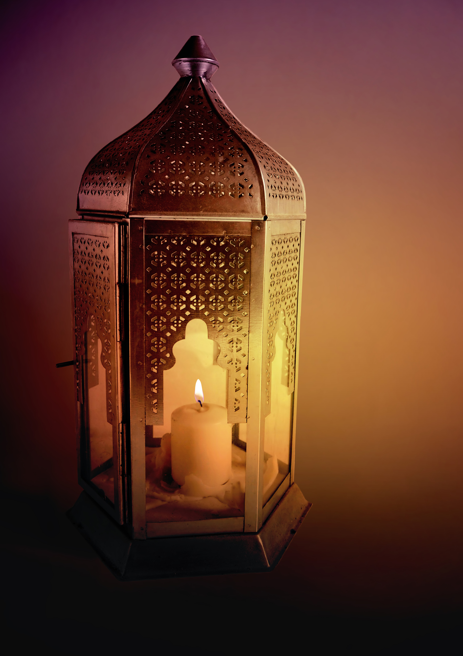
Have I Tried…
Working on my ……Gratitude, forgiveness, compassion, mercy, love, humility, respect, justice, joy, hope, courage, patience, truthfulness/integrity?
Rising above the evil inclinations of my heart, and transforming my Darkness into Light?
Seeking Direct Help from my Creator- The Only Creator of something from nothing, Lord of The Worlds- to Whom Belong the Most Beautiful Attributes, and Who is Able to do all things. The One on Whom I rely, To Whom we belong, and to Whom we Return?
Sending peace upon humanity and all of creation. Blessings those who curse me? Forgiving those who hate me? Repaying evil with good, Darkness with Light? Overcoming falsehood with Truth?
PEACE AND BLESSINGS BE WITH YOU

